Slide 1
Case study: Whiskers - Cat food app
Saqib Islam
Dec 24, 2024

Slide 2
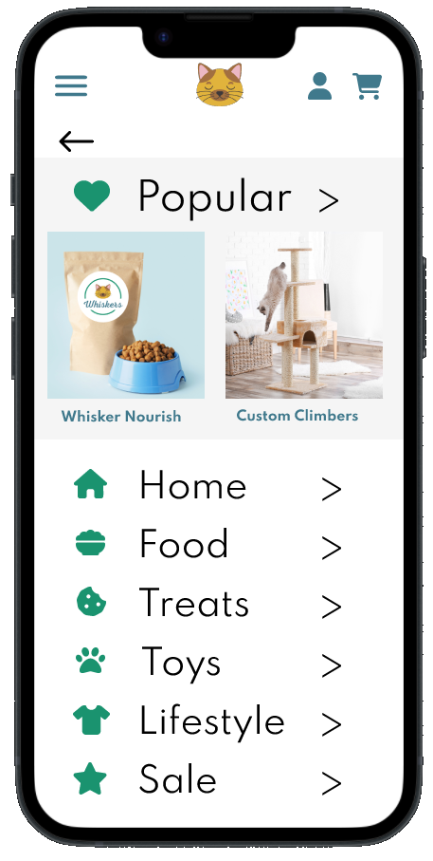
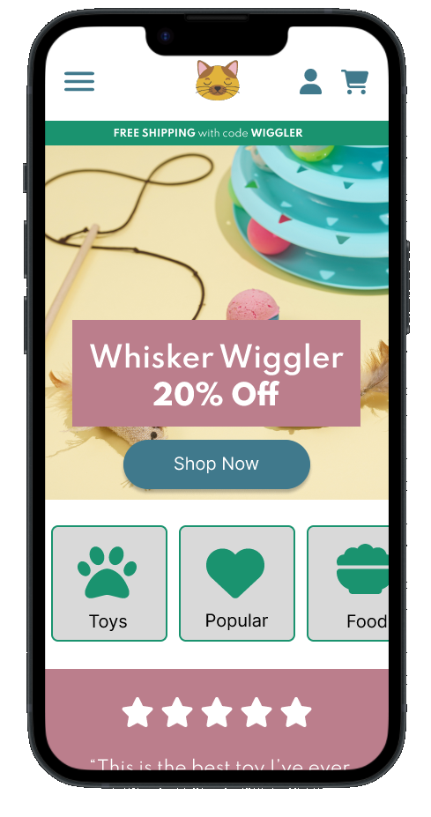
Project overview
The product:
An app to purchase specialized organic cat food and other items.
Project duration:
February - April, 2023

Slide 3
Project overview
The problem:
Busy people don’t have time to shop for high quality cat food. Some people need screen readers to order and they are not always able to be used on sites.
The goal:
Design an easy to use cat food ordering app that people who use screen readers can use.

Slide 4
Project overview
My role:
UX Researcher and Designer
Responsibilities:
User research, wireframing, prototyping, stakeholder feedback, user interface design.

Slide 5
User research
Personas
Problem statements
User journey maps
Understanding
the user

Slide 6
User research: summary
The research conducted was through interviews, user profiles, competitive audits and usability studies.
We knew that there are a lot of cat owners out there but underestimated the variety of types of cat owners. Many of them have a disability that prevents them from shopping in a store and carrying heavy bags but many also have a disability that makes shopping online difficult. The level of computer literacy varies so the app needs to be very intuitive and easy to use.

Slide 7
User research: pain points
1
2
3
4
Overwhelm
Heavy
Food Information
Screen Readers
People are often overwhelmed by cat food choices.
People with multiple cats often struggle to pick up heavy cat food from the store.
People would like clear information on cat food ingredients.
People who rely on screen readers can’t easily order cat food online.

Slide 8

“Spend more time doing what you love”
Add image that represents this persona
Goals
To balance the pressures of work, family and hobbies
To be able to take care of shopping and errands quickly and efficiently
To find quality products easily
Frustrations
“Many online retailers aren’t compatible with screenreaders, making my shopping choices more limited.”
“I love our cats but I actually hate shopping and would prefer to be listening to my ipod and running.”
“I can’t always stop in a store easily to pick up cat food and would love to find a way to get something shipped ahead of time.”
Frankie
Age:
Education:
Hometown:
Family:
Occupation:
35
MD
Omaha, NB
Partner, 2 kids
Pediatrician
Frankie has a busy and sometimes unpredictable schedule at work. They are also committed to training for an upcoming marathon. It is important to them to outsource or find efficient ways to help run things in the home so they can spend more time with their family and on their hobbies. Frankie often uses screenreaders when working and shopping online and will often avoid online stores that aren’t compatible with that. Frankie loves the option to subscribe and save with items they frequently need to buy because they don’t like wasting time on these tasks.

Slide 9

“If it's not cute and healthy I don’t need it. And my cats happen to be super cute!”
Add image that represents this persona
Goals
To find healthy cat food that maintains her cat’s healthy lives
To find a delivery option that’s easy and reduces what she has to carry home
Frustrations
“It’s often difficult to figure out the ingredients in cat food”
“I swear some apps still look like they were designed in the dark ages.”
“If the shipping cost isn’t easy to find, honestly i probably won’t buy it.”
Morgan
Age:
Education:
Hometown:
Family:
Occupation:
23
BA English
Chicago, IL
Single
Junior Copy Editor
Morgan is a single woman early in her career. She is ambitious at her copy editing job. In her free time she loves doting on her cats and decorating her first apartment. She is artistic and loves following trends. She cares about her health and always checks ingredients of just about anything she consumes. She doesn’t have a car yet so getting things home from the store can be a challenge. She’s used to shopping online a lot and will refuse to purchase from somewhere if the site is too confusing or doesn’t have features she’s come to expect.

Slide 10
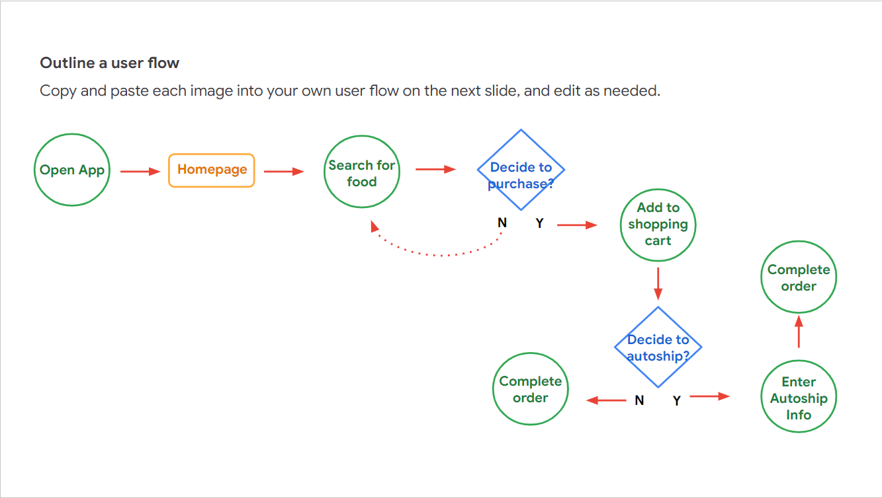
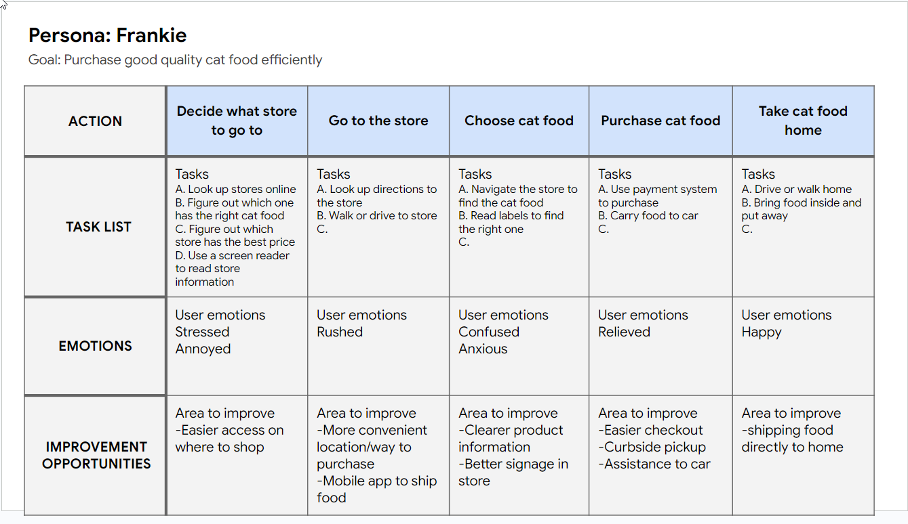
User journey map
We wanted the app to be easy to use and showcase the easy shipping options for people that have difficulty shopping in store.

Slide 11
Frankie
Busy doctor with a vision impairment
To easily shop for cat food online
Because shopping in the store is too difficult and takes too much time.

Slide 12
Paper wireframes
Digital wireframes
Low-fidelity prototype
Usability studies
Starting
the design

Slide 13
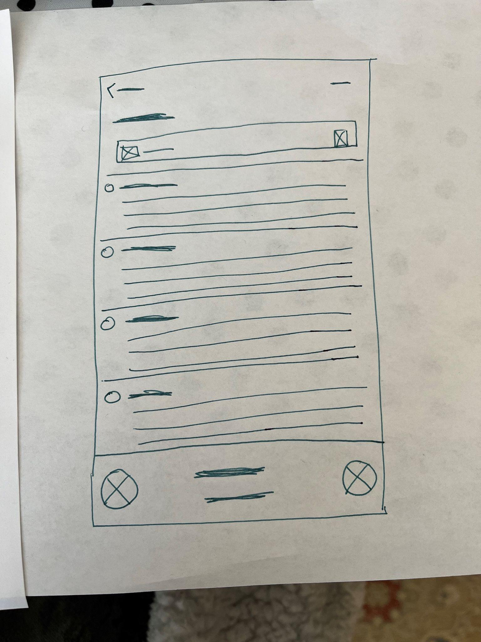
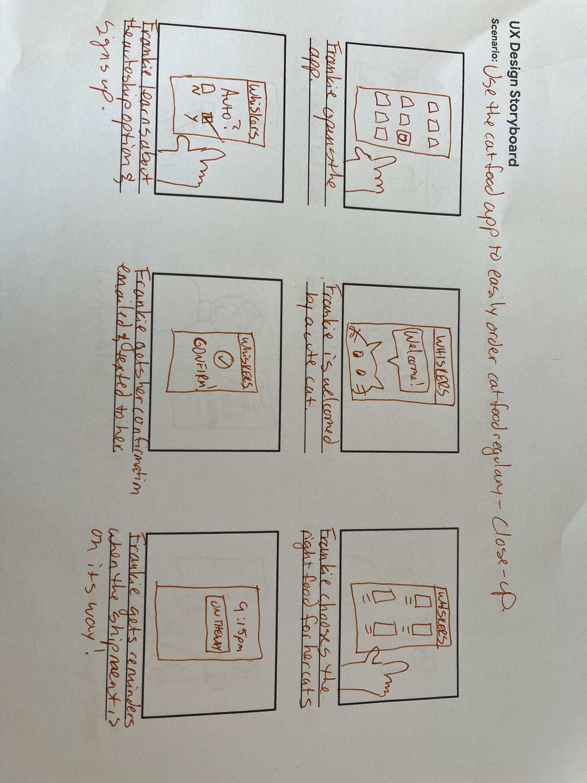
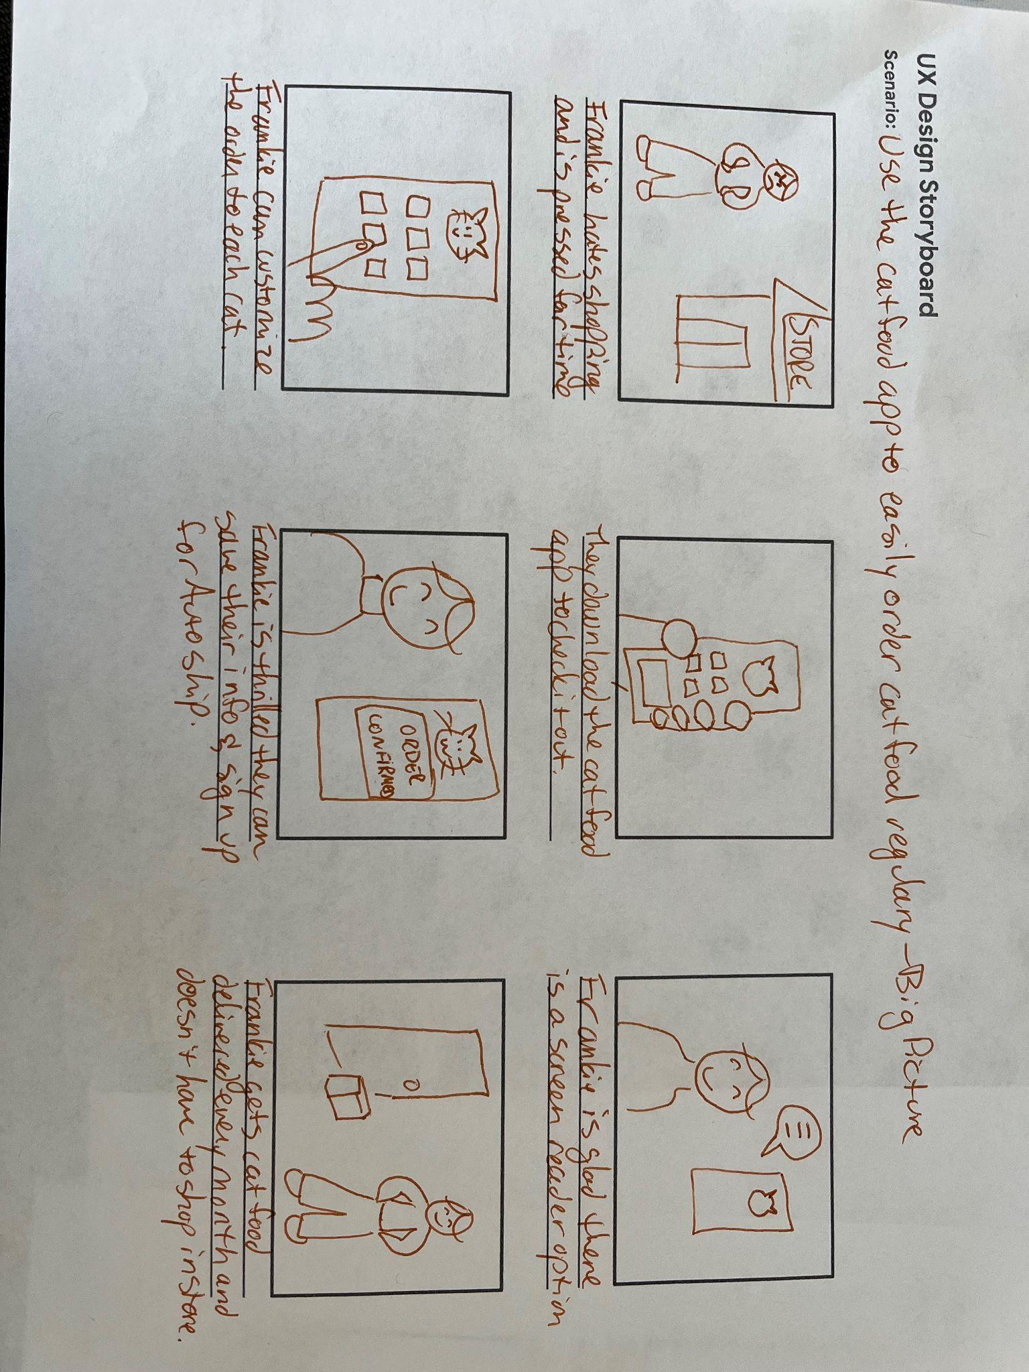
Paper wireframes
The goal of the paper wireframes was to quickly show how a user will navigate the app during their day to day life.

Slide 14
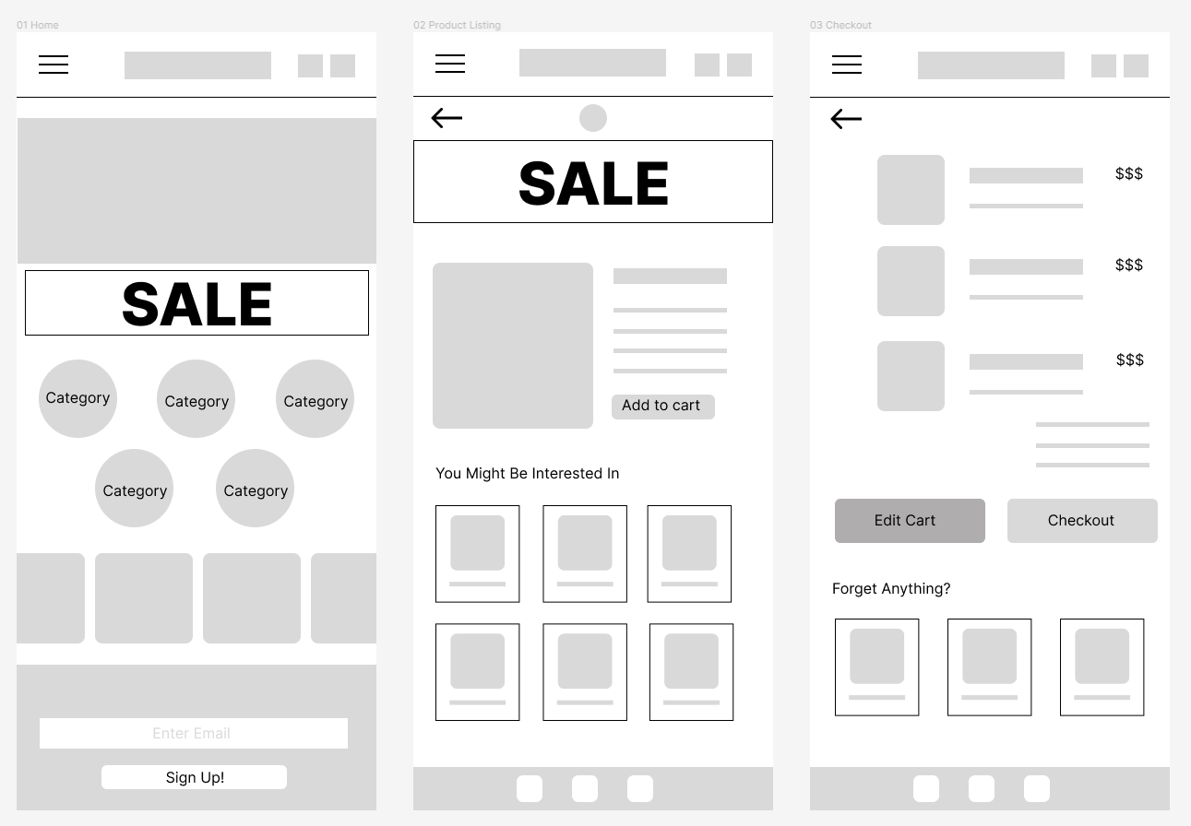
Digital wireframes
The first digital wireframe focused mainly on a quick checkout process. Our first users were confused by a lack of confirmation screen and also by so many product choices.
This element was initially to highlight discounted items.
This section was to highlight any products compatible with their current selection they might have missed.

Slide 15
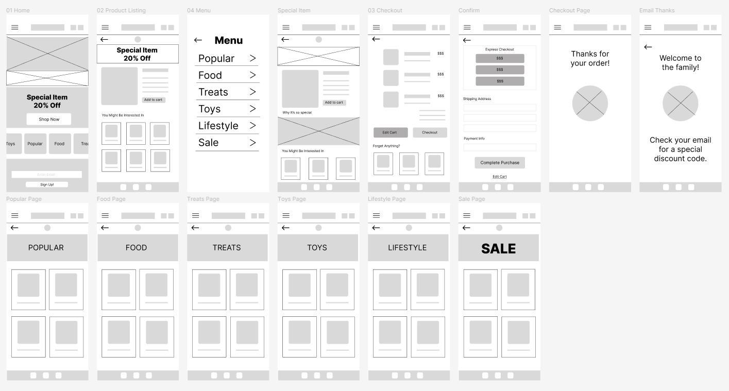
Changed our main screen discount offering.
Added a clearer menu
Added ability to express checkout.
Clear confirmation page.
Digital wireframes
Our second wireframe featured a more robust menu for easier navigation. We want to highlight main categories up front so users can find what they need quickly. We also realized that highlighting flagship items or a specific item that is on sale, is less confusing to users.
Categories are clean and easy to navigate

Slide 16
Usability study: findings
We did a usability test with five different users. They were asked to add a food item and lifestyle item to the cart. Then they were asked to enter their email for a discount. A summary of the challenges they experienced are below.
Round 1 findings
1
Navigation to home was difficult.
2
Entering your email for discount wasn’t clear.
3
Lack of images made it difficult to distinguish categories and items.

Slide 17
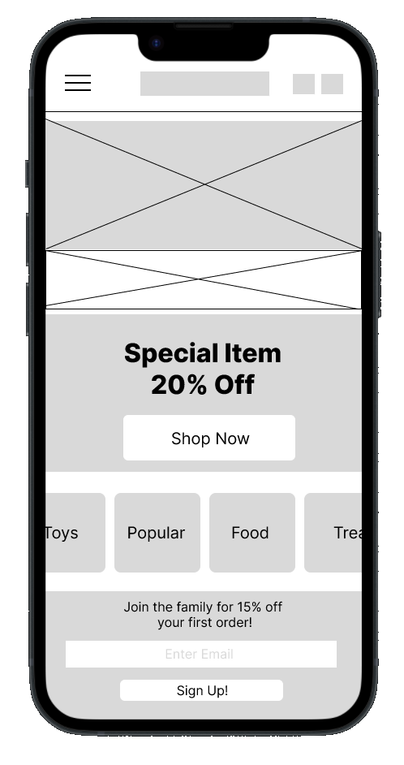
Made a clickable home header.
Low-fidelity prototype
Link to prototype.
This prototype was created after we went out to five users for a usability study. They found that navigating to home was difficult and distinguishing between categories was hard. They could not figure out how to enter their email to get the discount from other areas of the site.

Slide 18
Next Steps
Create a High fidelity prototype with images and colors to assist with distinguishing the product offerings.
Continue designing with scrolling capabilities in order to include items like entering email for discount code on each page.
Conduct an accessibility study to see if the app can be used with a screen reader.

Slide 19
Refining
the design
Mockups
High-fidelity prototype
Accessibility

Slide 20
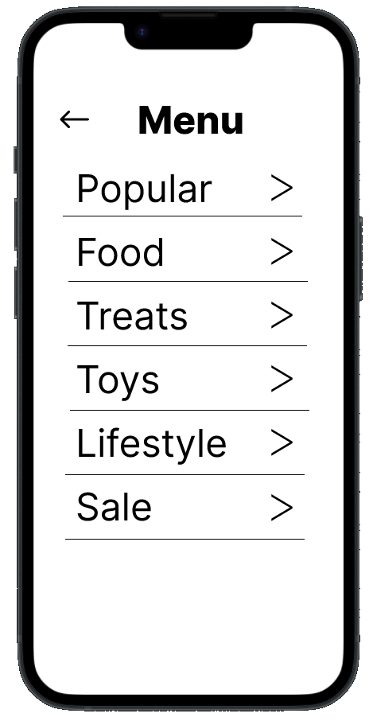
Mockups
Before usability study
After usability study
We wanted there to be multiple points of entry for the user to find what they need, however the main menu needs to be easy to navigate. The addition of images and icons to help navigation grew out of our usability study.

Slide 21
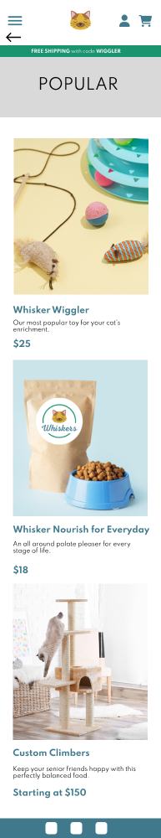
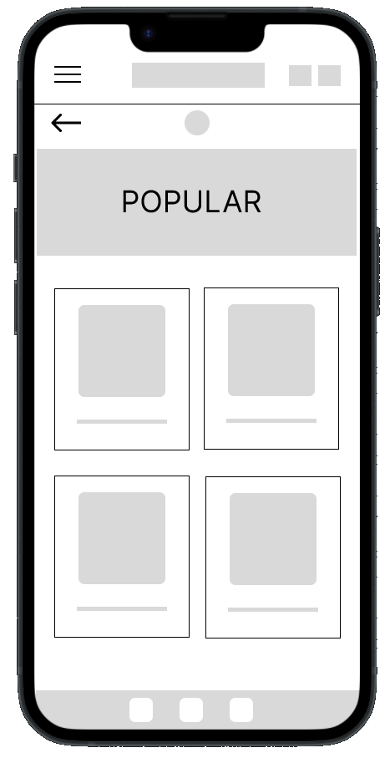
Before usability study
After usability study
Mockups
Initially our pages crammed everything on screen at once. But since the product selection is limited and specialized it makes more sense to allow the user to scroll and see clearer images of the products.

Slide 22
Mockups
Main mockup screen for display
Main mockup screen for display
Main mockup screen for display
Main mockup screen for display

Slide 23
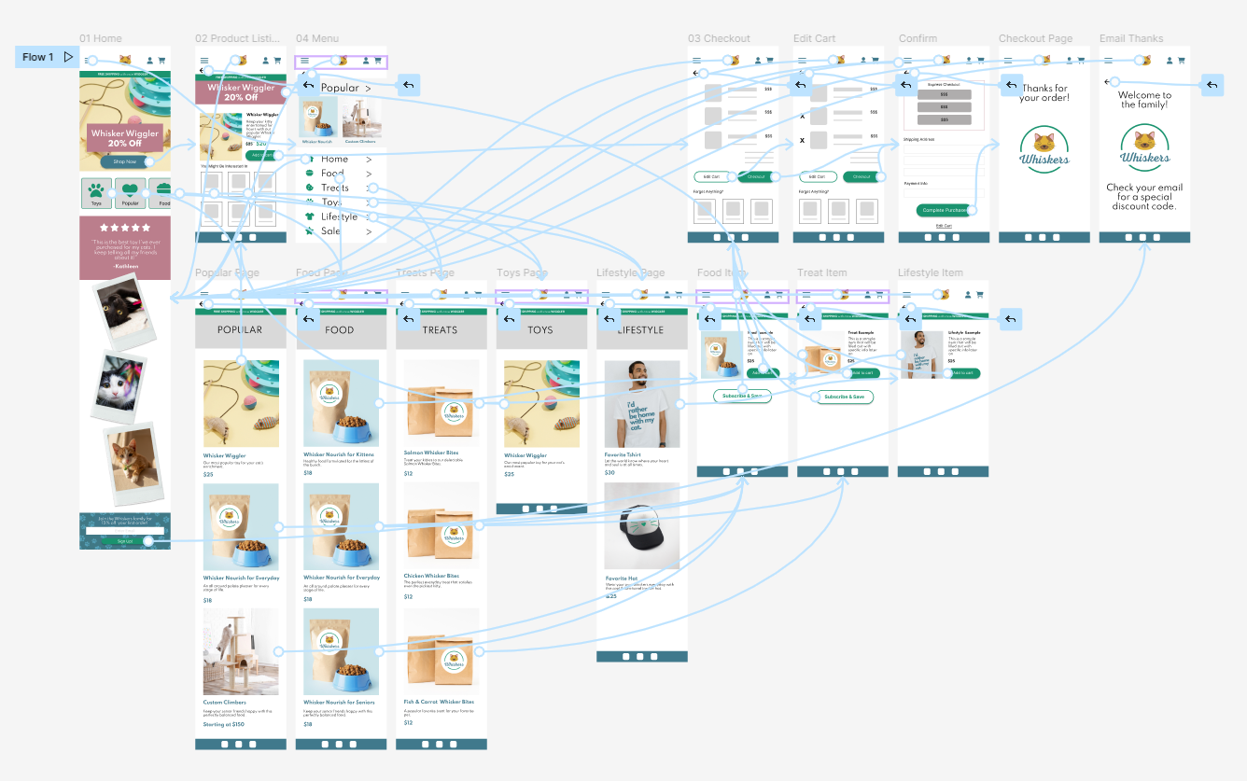
High-fidelity prototype
Link to prototype

Slide 24
Accessibility considerations
1
2
3
Used icons to make categories easier to navigate.
Updated colors to be consistent with brand color palette.
Used detailed imagery to convey products.

Slide 25
Going forward
Takeaways
Next steps

Slide 26
Takeaways
Impact:
The app really makes the process of ordering cat food pleasant. It meets users needs by creating a seamless ordering process with unique products.
What I learned:
I learned that it is dangerous to assume you know what the user will find easiest to use. Running it through a usability study was the most helpful. I think in real time I would make sure to keep usability studies regularly throughout the process.

Slide 27
Next steps
1
2
Continue adding products and building out the functionality of the shopping cart.
Conduct another usability study to determine any areas that need addressing.

